Slide 1
DataBase

Slide 2
Relational Data Model
Relational Algebra
Relational Calculus

Slide 3
Relation
Mathematics extension n of Set theory
D₁ = {1, 2, 3}; D₂ = {A, B, C, D};
relation with domain D₁ and D₂ ⊂ {(1, A), (1, B), (1, C), (1, D), (2, A), (2, B), (2, C), (2, D), (3, A), (3, B), (3, C), (3, D)} Cartesian Power set of D₁ X D₂

Slide 4
data model (relational data model) must include a set of operations to manipulate the database, in addition to data model’s concepts for defining database’s structure and constraints

Slide 5
Relational Algebra
basic set of operations for the formal relational model is the relational algebra
operations enable a user to specify basic retrieval requests as relational algebra expressions; result of a retrieval query is a relation – relational algebra operations thus produce relations, which can be further manipulated using operations of the same algebra
a sequence of relational algebra operations forms a relational algebra expression, whose result will also be a relation that represents the result of a database query (or retrieval request)

Slide 6
Relational Algebra
provides a formal foundation for relational model operations
used as a basis for implementing and optimizing queries in query processing and optimization modules that are integral parts of relational database management systems (RDBMSs)
some of its concepts are incorporated into the SQL standard

Slide 7
Relational Calculus
relational calculus provides a higher-level declarative language for specifying relational queries
in a relational calculus expression, there is no order of operations to specify how to retrieve query result - only what information the result should contain
has a firm basis in mathematical logic
standard query language (SQL) for RDBMSs has some of its foundations in a variation of relational calculus known as tuple relational calculus

Slide 8
Relational Algebra

Slide 9
Relational Algebra
is often considered to be an integral part of relational data model
relational algebra operations
  set operations from mathematical set theory; applicable because each relation is defined to be set of tuples
    include UNION, INTERSECTION, SET DIFFERENCE, and CARTESIAN PRODUCT (also known as CROSS PRODUCT)
  operations developed specifically for relational databases: SELECT, PROJECT, and JOIN
    SELECT and PROJECT unary operations that operate on single relations
    JOIN and other complex binary operations, which operate on two tables by combining related tuples (records) based on join conditions

Slide 10
Relational Algebra
some common database requests cannot be performed with original relational algebra operations, so additional operations were created to express these requests
include aggregate functions, which are operations that can summarize data from tables, as well as additional types of JOIN and UNION operations, known as OUTER JOINs and OUTER UNIONs

Slide 11
Relational Calculus
there are two variations of relational calculus
tuple relational calculus
domain relational calculus
formal language, based on mathematical logic called predicate calculus
in tuple relational calculus, variables range over tuples
in domain relational calculus, variables range over domains (values) of attributes
Query-By-Example (QBE) language, is a graphical user-friendly relational language based on domain relational calculus

Slide 12
SELECT Operation
used to choose a subset of tuples from relation that satisfies selection condition
filter that keeps only those tuples that satisfy condition
restrict tuples in relation to only those tuples that satisfy condition
horizontal partition of relation into two sets of tuples: those tuples that satisfy condition and are selected, and those tuples that do not satisfy condition and are filtered out
denoted by: σ_{<selection condition>}(R)

Slide 13
the Greek letter sigma is written as Σ (uppercase) and σ (lowercase)

Slide 14
SELECT Operation
for example, to select EMPLOYEE tuples whose department is 4, or those whose salary is greater than $30,000:
σ_{Dno=4}(EMPLOYEE)
σ_{Salary>30000}(EMPLOYEE)

Slide 15
SELECT Operation
symbol σ (sigma) is used to denote SELECT operator and selection condition is a Boolean expression (condition) specified on attributes of relation R
R is generally a relational algebra expression whose result is relation
  simplest such expression is just a database relation
relation resulting from SELECT operation has same attributes as R
Boolean expression specified in <selection condition> is made up of number of clauses of the form:
<attribute name> <comparison op> <constant value>
or <attribute name> <comparison op> <attribute name>

Slide 16
SELECT Operation
where <attribute name> is name of an attribute of R
<comparison op> is normally one of operators {=, <, ≤, >, ≥, ≠}
<constant value> is a constant value from attribute domain
clauses can be connected by standard Boolean operators and, or, and not
for example, to select tuples for all employees who either work in department 4 and make over $25,000 per year, or work in department 5 and make over $30,000:
σ(Dno=4 AND Salary>25000) OR (Dno=5 AND Salary>30000)(EMPLOYEE)

Slide 17
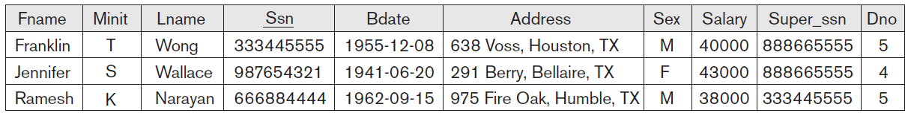

Slide 18
SELECT Operation
all comparison operators {=, <, ≤, >, ≥, ≠} can apply to attributes whose domains are ordered values, such as numeric or date domains or strings of characters considered to be ordered based on collating sequence of characters
only comparison operators {=, ≠} can apply to attributes whose domains are a set of unordered values (Boolean, color, gender, …)

Slide 19
SELECT Operation
result of SELECT operation can be determined as follows:
<selection condition> is applied independently to each individual tuple t in R
  substituting each occurrence of attribute A_{i} in selection condition with its value in tuple t[A_{i}]
  if condition evaluates to TRUE, then tuple t is selected
selected tuples appear in result
Boolean conditions AND, OR, and NOT have their normal interpretation

Slide 20
SELECT Operation
is unary; applied to a single relation
applied to each tuple individually: selection conditions cannot involve more than one tuple
the degree of relation resulting from a SELECT operation - its number of attributes - is the same as the degree of R
number of tuples in resulting relation is always less than or equal to number of tuples in R: |σ_{c} (R)| ≤ |R| for any condition C
fraction of tuples selected by selection condition is referred to as the selectivity of condition

Slide 21
SELECT Operation
commutative; that is,
σ_{<cond1>}(σ_{<cond2>}(R)) = σ_{<cond2>}(σ_{<cond1>}(R))
sequence of SELECTs can be applied in any order
can combine cascade (or sequence) of SELECT operations into single SELECT operation with a conjunctive (AND) condition
σ_{<cond1>}(σ_{<cond2>}(... (σ_{<condn>}(R)) ...)) =
σ<cond1> AND<cond2> AND...AND <condn>(R)

Slide 22
SELECT Operation
in SQL, the SELECT condition is typically specified in WHERE clause
for example, following operation:
σ_{Dno=4 AND Salary>25000} (EMPLOYEE)
would correspond to the following SQL query:
SELECT *
FROM EMPLOYEE
WHERE Dno=4 AND Salary>25000;

Slide 23
PROJECT Operation
selects certain columns/attributes from table/relation and discards others
SELECT operation chooses some of the rows/ tuples from table/relation while discarding other
interested in only certain attributes of a relation, we use PROJECT operation to project relation over these attributes only
vertical partition of relation into two relations: one has the needed columns (attributes) and contains result of operation, and the other contains discarded columns

Slide 24
PROJECT Operation
general form:
π_{<attribute list>}(R)
for example, to list each employee’s first and last name and salary
π_{Lname, Fname, Salary}(EMPLOYEE)

Slide 25
the Greek letter pi is written as Π (uppercase) and π (lowercase)

Slide 26
PROJECT Operation
symbol π (pi) used to represent PROJECT operation, and <attribute list> is desired list of attributes from attributes of relation R
R is a relational algebra expression whose result is a relation, which in simplest case is just name of database relation
result of PROJECT operation has only the attributes specified in <attribute list> in the same order as they appear in the list
degree is equal to number of attributes in <attribute list>

Slide 27
PROJECT Operation
if attribute list includes only non key attributes of R, duplicate tuples are likely to occur; PROJECT operation removes any duplicate tuples, so the result of PROJECT operation is a set of distinct tuples, and hence a valid relation; this is known as duplicate elimination

Slide 28
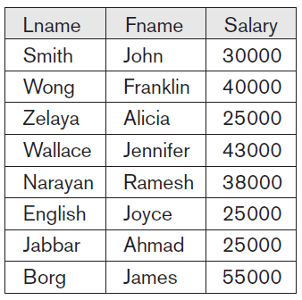
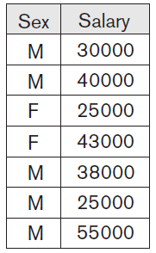
π_{Lname, Fname, Salary}(EMPLOYEE) π_{Sex, Salary}(EMPLOYEE)

Slide 29
PROJECT Operation
notice that tuple <‘F’, 25000> appears only once even though this combination of values appears twice in EMPLOYEE relation
duplicate elimination involves sorting or some other technique to detect duplicates and thus adds more processing
if duplicates are not eliminated, result would be multiset or bag of tuples rather than a set; not permitted in the formal relational model but is allowed in SQL

Slide 30
PROJECT Operation
number of tuples in relation resulting from PROJECT operation is always less than or equal to number of tuples in R
if projection list is superkey of R resulting relation has same number of tuples as R

Slide 31
PROJECT Operation
π_{<list1>}(π_{<list2>}(R)) = π_{<list1>}(R)
as long as <list2> contains attributes in <list1>; otherwise, left-hand side is an incorrect expression
commutativity does not hold on PROJECT

Slide 32
PROJECT Operation
In SQL, PROJECT attribute list is specified in SELECT clause of query
for example:
π_{Sex, Salary}(EMPLOYEE)
would correspond to the following SQL query:
SELECT DISTINCT Sex, Salary
FROM EMPLOYEE

Slide 33
Sequences of Operations
most queries apply several relational algebra operations one after the other
can write operations as single relational algebra expression by nesting operations
or we can apply one operation at time and create intermediate result relations; in the latter case, we must give names to relations that hold intermediate results

Slide 34
for example, to retrieve first name, last name and salary of all employees who work in department number 5:
π_{Fname, Lname, Salary}(σ_{Dno=5}(EMPLOYEE))
DEP5_EMPS ← σ_{Dno=5}(EMPLOYEE)
RESULT ← π_{Fname, Lname, Salary}(DEP5_EMPS)

Slide 35
Rename operation
using the assignment operation, denoted by ← (left arrow)
sometimes simpler to break down a complex sequence of operations by specifying intermediate result relations than to write a single relational algebra expression
can also use this technique to rename attributes in intermediate and result relations: list new attribute names in parentheses:
R(First_name, Last_name, Salary) ← π_{Fname, Lname, Salary}(DEP5_EMPS)

Slide 36
RENAME operation
if no renaming is applied, names of attributes in resulting relation
SELECT operation are the same as those in original relation and in same order
PROJECT operation has the same attribute names as those in projection list and in same order in which they appear in list
can also define formal RENAME operation, which rename either relation name or attribute names, or both, as unary operator
RENAME operation when applied to relation R of degree n is denoted by:
ρ_{S(B1, B2, ... , Bn)}(R) or ρ_{S}(R) or ρ_{(B1, B2, ... , Bn)}(R)

Slide 37
the Greek letter rho is written as Ρ (uppercase) and ρ (lowercase)

Slide 38
RENAME operation
symbol ρ (rho) is used to denote the RENAME operator, S is the new relation name, and B1, B2, … , Bn are the new attribute names
first expression renames both relation and its attributes
second renames relation only
third renames attributes only: if the attributes of R are (A1, A2, … , An) in that order, then each Ai is renamed as Bi

Slide 39
UNION, INTERSECTION, and MINUS Operations
standard mathematical operations on sets UNION, INTERSECTION, and SET DIFFERENCE (also called MINUS or EXCEPT)
these are binary operations: that is, each is applied to two sets (of tuples)

Slide 40
two relations on which any of these three operations are applied must have same type of tuples; condition has been called union compatibility or type compatibility
two relations R(A₁, A₂, … , A_{n}) and S(B1, B₂, … , B_{n}) are said to be union compatible (or type compatible) if they have same degree n and if dom(A_{i}) = dom(B_{i}) for 1 ≤ i ≤ n
two relations have same number of attributes and each corresponding pair of attributes has same domain

Slide 41
UNION: result of this operation, denoted by R ∪ S, is a relation that includes all tuples that are either in R or in S or in both R and S; duplicate tuples are eliminated
INTERSECTION: result of this operation, denoted by R ∩ S, is a relation that includes all tuples that are in both R and S
SET DIFFERENCE (or MINUS): result of this operation, denoted by R – S, is a relation that includes all tuples that are in R but not in S

Slide 42
in SQL, there are three operations - UNION, INTERSECT, and EXCEPT - that correspond to the set operations
in addition, there are multiset operations UNION ALL, INTERSECT ALL, and EXCEPT ALL that do not eliminate duplicates

Slide 43
CARTESIAN PRODUCT (CROSS PRODUCT)
Operation
CARTESIAN PRODUCT operation - also known as CROSS PRODUCT or CROSS JOIN - which is denoted by ×
binary set operation, but relations on which it is applied do not have to be union compatible
produces a new element by combining every member (tuple) from one relation (set) with every member (tuple) from other relation (set)
result of R(A1, A2, … , An) × S(B1, B2, … , Bm) is a relation Q with degree n + m attributes Q(A1, A2, … , An, B1, B2, … , Bm), in that order; resulting relation Q has one tuple for each combination of tuples one from R and one from S

Slide 44
Q will have |R| * |S| = |R × S| tuples – expensive operation!

Slide 45
for example, suppose that we want to retrieve a list of names of each female employee’s dependents
FEMALE_EMPS ← σ_{Sex=‘F’}(EMPLOYEE)
EMPNAMES ← π_{Fname, Lname, Ssn}(FEMALE_EMPS)
EMP_DEPENDENTS ← EMPNAMES × DEPENDENT
ACTUAL_DEPENDENTS ← σ_{Ssn=Essn}(EMP_DEPENDENTS)
RESULT ← π_{Fname, Lname, Dependent_name}(ACTUAL_DEPENDENTS)

Slide 46
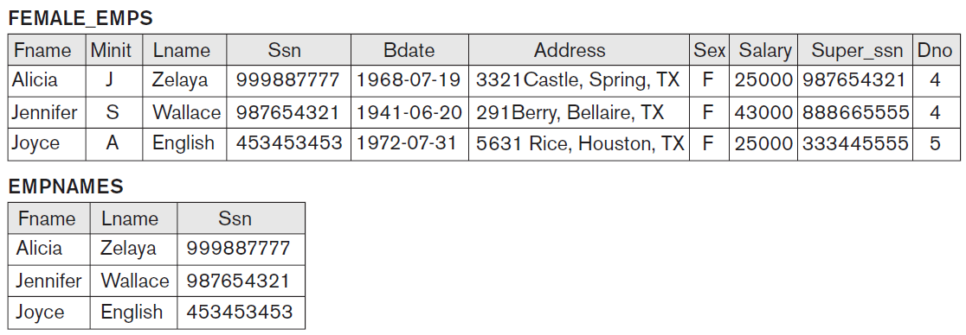

Slide 47
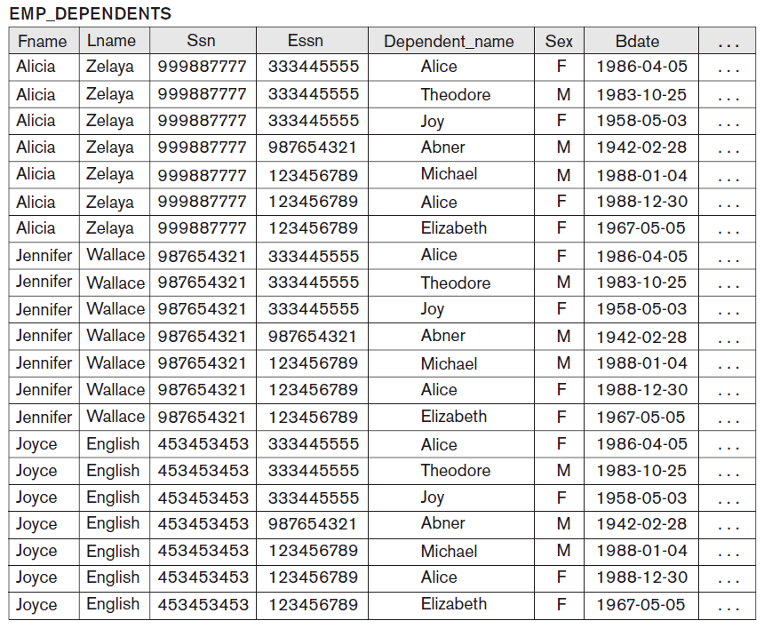

Slide 48
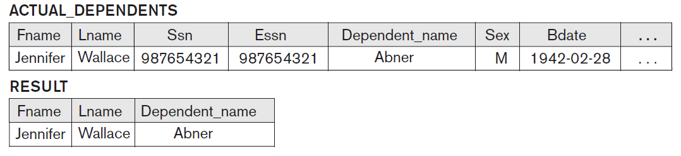

Slide 49
in SQL, CARTESIAN PRODUCT can be realized by using CROSS JOIN option in joined tables
alternatively, if there are two tables in FROM clause and there is no corresponding join condition in WHERE clause of SQL query, result will also be CARTESIAN PRODUCT of the two tables

Slide 50
CARTESIAN PRODUCT creates tuples with combined attributes of two relations
can SELECT related tuples only from two relations by specifying appropriate selection condition after the Cartesian product
because this sequence of CARTESIAN PRODUCT followed by SELECT is quite commonly used to combine related tuples from two relations, a special operation, called JOIN, was created to specify this sequence as a single operation

Slide 51
JOIN Operation
denoted by ⨝ is used to combine related tuples from two relations into single tuples
important for relational database because it allows to process relationships among relations
for example, to retrieve name of manager of each department, need to combine each department tuple with employee tuple whose Ssn value matches the Mgr_ssn value in department tuple
DEPT_MGR ← DEPARTMENT ⨝_{Mgr_ssn=Ssn}EMPLOYEE
RESULT ← π_{Dname, Lname, Fname}(DEPT_MGR)

Slide 52
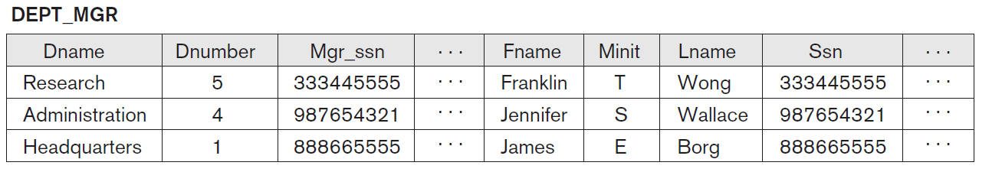

Slide 53
note that Mgr_ssn is foreign key of the DEPARTMENT relation that references Ssn, primary key of EMPLOYEE relation
referential integrity constraint plays a role in having matching tuples in referenced relation
JOIN operation can be specified as CARTESIAN PRODUCT operation followed by a SELECT operation

Slide 54
EMP_DEPENDENTS ← EMPNAMES × DEPENDENT
ACTUAL_DEPENDENTS ← σ_{Ssn=Essn}(EMP_DEPENDENTS)
can be replaced with single JOIN operation:
ACTUAL_DEPENDENTS ← EMPNAMES⨝_{Ssn=Essn}DEPENDENT

Slide 55
general form of a JOIN operation on two relations R(A1, A2, … , An) and S(B1, B2, … , Bm) is
R ⨝_{<join condition>} S
result of the JOIN is relation Q with n + m attributes Q(A1, A2, … , An, B1, B2,… , Bm) in that order; Q has one tuple for each combination of tuples, one from R and one from S, whenever combination satisfies the join condition - main difference between CARTESIAN PRODUCT and JOIN - in JOIN, only combinations of tuples satisfying join condition appear in result, whereas in CARTESIAN PRODUCT all combinations of tuples are included in result

Slide 56
join condition is specified on attributes from the two relations R and S and is evaluated for each combination of tuples
general join condition is of the form
<condition> AND <condition> AND … AND <condition>
where each <condition> is of the form A_{i} θ B_{j}, A_{i} is attribute of R, B_{j} is attribute of S, A_{i} and B_{j} have the same domain, and θ (theta) is one of the comparison operators {=, <, ≤, >, ≥, ≠}
a JOIN operation with such a general join condition is called THETA JOIN

Slide 57
Alpha - Α α
Beta - Β β
Gamma - Γ γ
Delta - Δ δ
Epsilon - Ε ε
Zeta - Ζ ζ
Eta - Η η
Theta - Θ θ
Iota - Ι ι
Kappa - Κ κ
Lambda - Λ λ
Mu - Μ μ
Nu - Ν ν
Xi - Ξ ξ
Omicron - Ο ο
Pi - Π π
Rho - Ρ ρ
Sigma - Σ σ/ς
Tau - Τ τ
Upsilon - Υ υ
Phi - Φ φ
Chi - Χ χ
Psi - Ψ ψ
Omega - Ω ω

Slide 58
tuples whose join attributes are NULL, or for which join condition is FALSE do not appear in result
JOIN operation does not necessarily preserve all of information in participating relations, because tuples that do not get combined with matching ones in other relation do not appear in result

Slide 59
EQUIJOIN
most common use of JOIN involves join conditions with equality comparisons only
such a JOIN, where only comparison operator used is =, is called EQUIJOIN
previous examples were EQUIJOINs
notice that in result of an EQUIJOIN we always have one or more pairs of attributes that have identical values in every tuple; for example, values of attributes Mgr_ssn and Ssn are identical in every tuple of DEPT_MGR (EQUIJOIN result) because the equality join condition specified on these two attributes requires the values to be identical in every tuple in the result

Slide 60
NATURAL JOIN
because one of each pair of attributes with identical values is superfluous, operation called NATURAL JOIN, denoted by ⨝* was created to get rid of second (superfluous) attribute in EQUIJOIN
standard definition of NATURAL JOIN requires that the two join attributes (or each pair of join attributes) have the same name in both relations; if this is not the case, renaming operation is applied
NATURAL JOIN is basically an EQUIJOIN followed by removal of the superfluous attributes

Slide 61
Inner JOIN
single JOIN operation is used to combine data from two relations so that related information can be presented in single table
these operations are also known as inner joins, to distinguish them from a different join variation called outer joins
inner join is a type of match-and combine operation defined formally as a combination of CARTESIAN PRODUCT and SELECTION
sometimes a join may be specified between a relation and itself

Slide 62
Complete Set of Relational Algebra Operations
set of relational algebra operations {σ, π, ∪, ρ, –, ×} is a complete set; that is, any of the other original relational algebra operations can be expressed as a sequence of operations from this set
for example, the INTERSECTION operation can be expressed using UNION and MINUS as follows:
R ∩ S ≡ (R ∪ S) – ((R – S) ∪ (S – R))
strictly speaking, INTERSECTION is not required
it is inconvenient to specify this complex expression every time

Slide 63
another example, JOIN operation can be specified as CARTESIAN PRODUCT followed by SELECT operation, similarly, NATURAL JOIN can be specified as CARTESIAN PRODUCT preceded by RENAME and followed by SELECT and PROJECT operations
various JOIN operations are also not strictly necessary for expressive power of relational algebra
important to include as separate operations because they are convenient to use and are very commonly applied in database applications
other operations have been included in basic relational algebra for convenience rather than necessity

Slide 64
DIVISION Operation
denoted by ÷, is useful for special kind of query
for example Retrieve the names of employees who work on all the projects that ‘John Smith’ works on

Slide 65
retrieve list of project numbers that ‘John Smith’ works on in an intermediate relation
SMITH ← σ_{Fname=‘John’ AND Lname=‘Smith’}(EMPLOYEE)
SMITH_PNOS ← π_{Pno}(WORKS_ON ⨝ _{Essn=Ssn}SMITH)

Slide 66
create a relation that includes a tuple <Pno, Essn> whenever the employee whose Ssn is Essn works on project whose number is Pno in the intermediate relation:
SSN_PNOS ← π_{Essn, Pno}(WORKS_ON)

Slide 67
apply the DIVISION operation to the two relations, which gives the desired employees’ Social Security numbers:
SSNS(Ssn) ← SSN_PNOS ÷ SMITH_PNOS
RESULT ← π_{Fname, Lname}(SSNS ⨝* EMPLOYEE)

Slide 68
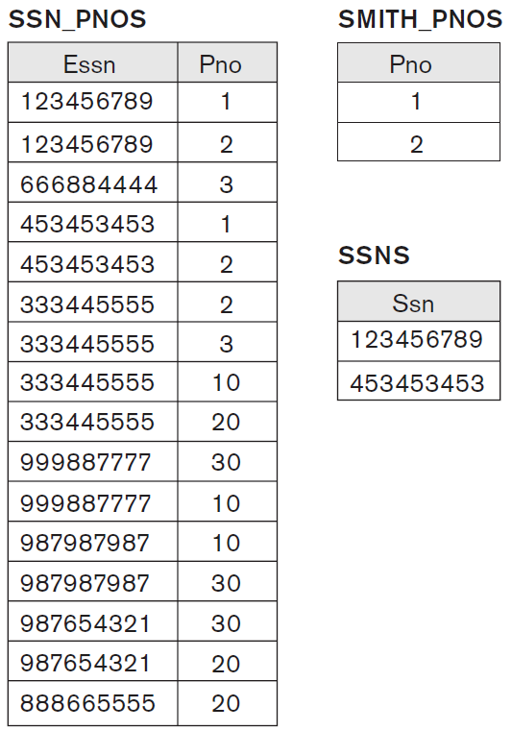

Slide 69
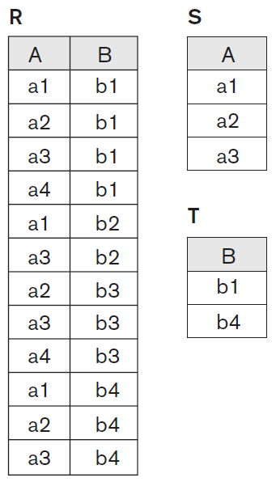
T ← R ÷ S.

Slide 70
DIVISION operation is applied to two relations R(Z) ÷ S(X), where attributes of S are subset of attributes of R; that is, X ⊆ Z
let Y be the set of attributes of R that are not attributes of S; that is, Y = Z – X (and hence Z = X ∪ Y)
DIVISION operation can be expressed:
T1 ← π_{Y}(R)
T2 ← π_{Y}((S × T1) – R)
T ← T1 – T2

Slide 71
DIVISION operation is defined for convenience for dealing with queries that involve universal quantification or the all condition
most RDBMS implementations with SQL as primary query language do not directly implement division - SQL has a roundabout way of dealing with the type of query

Slide 72
Notation for Query Trees
notation typically used in relational DBMSs (RDBMSs) to represent queries internally
notation is called a query tree or sometimes a query evaluation tree or query execution tree
includes the relational algebra operations being executed and is used asa possible data structure for the internal representation of the query in an RDBMS
query tree is a tree data structure that corresponds to a relational algebra expression

Slide 73
represents input relations of the query as leaf nodes of tree, and represents relational algebra operations as internal nodes
an execution of query tree consists of executing internal node operation whenever its operands (represented by its child nodes) are available, and then replacing that internal node by the relation that results from executing the operation
execution terminates when the root node is executed and produces the result relation for the query

Slide 74
For every project located in ‘Stafford’, list the project number, the controlling department number, and the department manager’s last name, address, and birth date
πPnumber, Dnum, Lname, Address, Bdate(((σ_{Plocation=‘Stafford’}(PROJECT))
⨝ _{Dnum=Dnumber}(DEPARTMENT)) ⨝ _{Mgr_ssn=Ssn}(EMPLOYEE))

Slide 75
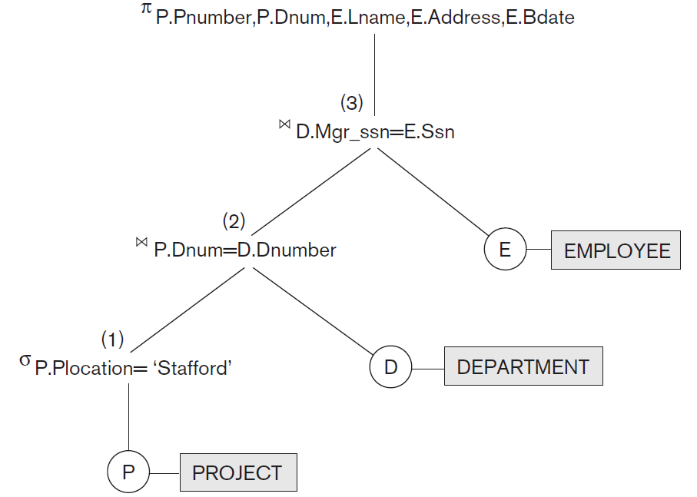

Slide 76
Additional Relational Operations
  Generalized Projection
  Aggregate Functions and Grouping
  Recursive Closure Operations
  OUTER JOIN Operations

Slide 77
Generalized Projection
extends the projection operation by allowing functions of attributes to be included in the projection list
π_{F1, F2, ..., Fn} (R)
where F₁, F₂, … , F_{n} are functions over the attributes in relation R and may involve arithmetic operations and constant values
helpful when computed values have to be produced in columns of query result

Slide 78
Aggregate Functions and Grouping
to specify mathematical aggregate functions on collections of values
common functions applied to collections of numeric values include SUM, AVERAGE, MAXIMUM, and MINIMUM; COUNT function is used for counting tuples or values

Slide 79
another type of request involves grouping tuples in a relation by the value of some of their attributes and then applying aggregate function independently to each group
for example, group EMPLOYEE tuples by Dno, so that each group includes tuples for employees working in same department

Slide 80
define an AGGREGATE FUNCTION operation, using symbol I (pronounced script F), to specify these types of requests as follows:
<grouping attributes> ℑ <function list> (R)
where <grouping attributes> is a list of attributes of relation specified in R, and <function list> is a list of (<function> <attribute>) pairs; in each such pair, <function> is one of the allowed functions, such as SUM, AVERAGE, MAXIMUM, MINIMUM, COUNT, and <attribute> is attribute of relation specified by R
resulting relation has grouping attributes plus one attribute for each element in function list

Slide 81
for example, to retrieve each department number, the number of employees in the department, and their average salary:
ρR(Dno, No_of_employees, Average_sal) (Dno ℑ COUNT Ssn, AVERAGE Salary (EMPLOYEE))

Slide 82
Recursive Closure Operations
operation is applied to recursive relationship between tuples of the same type, such as the relationship between employee and supervisor; relationship described by foreign key Super_ssn of EMPLOYEE relation and it relates each employee tuple (in the role of supervisee) to another employee tuple (in the role of supervisor)
for example, a recursive operation is to retrieve all supervisees of an employee e at all levels - that is, all employees e′ directly supervised by e, all employees e′′ directly supervised by each employee e′, all employees e″′ directly supervised by each employee e″, and so on

Slide 83
relatively straightforward in relational algebra to specify all employees supervised by e at a specific level by joining table with itself one or more times; difficult to specify all supervisees at all levels

Slide 84
BORG_SSN ← π_{Ssn}(σ_{Fname=‘James’ AND Lname=‘Borg’}(EMPLOYEE))
SUPERVISION(Ssn1, Ssn2) ← π_{Ssn,Super_ssn}(EMPLOYEE)
RESULT1(Ssn) ← π_{Ssn1}(SUPERVISION ⨝ _{Ssn2=Ssn}BORG_SSN)
RESULT2(Ssn) ← π_{Ssn1}(SUPERVISION ⨝ _{Ssn2=Ssn}RESULT1)
RESULT ← RESULT2 ∪ RESULT1

Slide 85
retrieve all employees supervised by Borg at level 1
retrieve all employees supervised by Borg at level 2
to get both sets of employees supervised at levels 1 and 2 by ‘James Borg’, we can apply the UNION operation to results

Slide 86
although it is possible to retrieve employees at each level and then take their UNION, we cannot, in general, specify a query such as “retrieve the supervisees of ‘James Borg’ at all levels” without utilizing a looping mechanism unless we know the maximum number of levels
an operation called transitive closure of relations has been proposed to compute the recursive relationship as far as the recursion proceeds

Slide 87
OUTER JOIN Operations
developed to take the union of tuples from two relations that have some common attributes but are not union (type) compatible.
operation will take of tuples in two relations R(X, Y) and S(X, Z) that are partially compatible, meaning that only some of their attributes, say X, are union compatible; attributes that are union compatible are represented only once in the result, and those attributes that are not union compatible from either relation are also kept in result relation T(X, Y, Z)

Slide 88
two tuples t₁ in R and t₂ in S are said to match if t₁[X] = t₂[X]; these will be combined (unioned) into a single tuple in t
tuples in either relation that have no matching tuple in other relation are padded with NULL values
all tuples from both relations are included in result, but tuples with the same attributes values combination will appear only once in the result

Slide 89
OUTER UNION can be applied to two relations whose schemas are STUDENT(Name, Ssn, Department, Advisor) and INSTRUCTOR(Name, Ssn, Department, Rank)
tuples from the two relations are matched based on having same combination of values of the shared attributes: Name, Ssn, Department
tuples appearing only in STUDENT will have a NULL for Rank attribute
tuples appearing only in INSTRUCTOR will have a NULL for Advisor attribute
tuple that exists in both relations, which represent a student who is also an instructor, will have values for all its attributes

Slide 90
Relational Calculus

Slide 91
Relational Calculus
tuple relational calculus
domain relational calculus
in both variations of relational calculus, we write one declarative expression to specify a retrieval request
there is no description of how to evaluate a query; calculus expression specifies what is to be retrieved rather than how to retrieve it
relational calculus is a nonprocedural language

Slide 92
differs from relational algebra, where we must write a sequence of operations to specify a retrieval request in a particular order of applying the operations; order also influences the strategy for evaluating query
it can be considered as a procedural way of stating a query

Slide 93
calculus expression may be written in different ways, but the way it is written has no bearing on how query should be evaluated

Slide 94
any retrieval that can be specified in basic relational algebra can also be specified in relational calculus, and vice versa
expressive power of the languages is identical
relational query language L is considered relationally complete if we can express in L any query that can be expressed in relational calculus

Slide 95
certain frequently required queries in database applications cannot be expressed in basic relational algebra or calculus
most relational query languages are relationally complete but have more expressive power than relational algebra or relational calculus because of additional operations such as aggregate functions, grouping, and ordering
relational calculus is important for two reasons
has a firm basis in mathematical logic
standard Structured Query Language (SQL) for RDBMSs has its basic foundation in the tuple relational calculus

Slide 96
Tuple Relational Calculus

Slide 97
Tuple Variables and Range Relations
tuple relational calculus is based on specifying a number of tuple variables
each tuple variable usually ranges over a particular database relation, meaning that the variable may take as its value any individual tuple from that relation
simple tuple relational calculus query is of the form:
{t | COND(t)}

Slide 98
simple tuple relational calculus query is of the form:
{t | COND(t)}
where t is a tuple variable and COND(t) is a conditional (Boolean) expression involving t that evaluates to either TRUE or FALSE for different assignments of tuples to variable t
result of such query is the set of all tuples t that evaluate COND(t) to TRUE; these tuples are said to satisfy COND(t)

Slide 99
for example, to find all employees whose salary is above $50,000:
{t | EMPLOYEE(t) AND t.Salary>50000}
condition EMPLOYEE(t) specifies that the range relation of tuple variable t is EMPLOYEE; each EMPLOYEE tuple t that satisfies condition t.Salary>50000 will be retrieved; t.Salary references attribute Salary of tuple variable t
notation resembles how attribute names are qualified with relation names or aliases in SQL

Slide 100
query retrieves all attribute values for each selected EMPLOYEE tuple t
to retrieve only some
{t.Fname, t.Lname | EMPLOYEE(t) AND t.Salary>50000}

Slide 101
specify following information in a tuple relational calculus expression:
for each tuple variable t, the range relation R of t; value is specified by condition of form R(t); if we do not specify range relation, then variable t will range over all possible tuples “in the universe” as it is not restricted to any one relation
condition to select particular combinations of tuples; condition is evaluated for every possible combination of tuples to identify selected combinations for which the condition evaluates to TRUE
set of attributes to be retrieved, the requested attributes; values of these attributes are retrieved for each selected combination of tuples

Slide 102
{t.Bdate, t.Address | EMPLOYEE(t) AND t.Fname=‘John’ AND t.Minit=‘B’ AND t.Lname=‘Smith’}
retrieve the birth date and address of employee (or employees) whose name is John B. Smith.

Slide 103
Expressions and Formulas in Tuple Relational Calculus
general expression of tuple relational calculus is of the form
{t₁.A_{j}, t₂.A_{k}, ... , t_{n}.A_{m} | COND(t₁, t₂, ..., t_{n}, t_{n+1}, t_{n+2}, ...)}
where t₁, t₂, ..., t_{n}, t_{n+1}, t_{n+2}, ... are tuple variables, each A_{i} is an attribute of relation on which t_{i} ranges, and COND is a condition or formula (called a well-formed formula, or WFF, in mathematical logic) of the tuple relational calculus
formula is made up of predicate calculus atoms, which can be one of the following:

Slide 104
atom of the form R(t_{i})
where R is a relation name and t_{i} is a tuple variable
this atom identifies the range of the tuple variable t_{i} as the relation whose name is R; it evaluates to TRUE if t_{i} is a tuple in the relation R

Slide 105
atom of the form t_{i}.A op t_{j}.B
where op is one of the comparison operators in the set {=, <, ≤, >, ≥, ≠}, t_{i} and t_{j} are tuple variables, A is an attribute of the relation on which t_{i} ranges, and B is an attribute of the relation on which t_{j} ranges

Slide 106
atom of the form t_{i}.A op c or c op t_{j}.B,
where op is one of the comparison operators in the set {=, <, ≤, >, ≥, ≠}, t_{i} and t_{j} are tuple variables, A is an attribute of the relation on which t_{i} ranges, B is an attribute of the relation on which t_{j} ranges, and c is a constant value

Slide 107
a formula (Boolean condition) is made up of one or more atoms connected via the logical operators AND, OR, and NOT and is defined recursively:
Rule 1: Every atom is a formula
Rule 2: If F₁ and F₂ are formulas, then so are (F₁ AND F₂), (F₁ OR F₂), NOT(F₁), and NOT (F₂)

Slide 108
Existential and Universal Quantifiers
special symbols called quantifiers can appear in formulas: universal quantifier (∀) and existential quantifier (∃)
free and bound tuple variables in a formula
  tuple variable t is bound if it is quantified, meaning that it appears in an (∃t) or (∀t) clause
  otherwise, it is free

Slide 109
F1: d.Dname = ‘Research’
F2: (∃t)(d.Dnumber = t.Dno)
F3: (∀d)(d.Mgr_ssn = ‘333445555’)
tuple variable d is free in both F1 and F2
tuple variable d is bound to the (∀) quantifier in F3
tuple variable t is bound to the (∃) quantifier in F2

Slide 110
a formula (Boolean condition) is made up of one or more atoms connected via the logical operators AND, OR, and NOT and is defined recursively:
Rule 1: Every atom is a formula
Rule 2: If F₁ and F₂ are formulas, then so are (F₁ AND F₂), (F₁ OR F₂), NOT(F₁), and NOT (F₂)
Rule 3: If F is a formula, then so is (∃t)(F), where t is a tuple variable; formula (∃t)(F) is TRUE if formula F evaluates to TRUE for some (at least one) tuple assigned to free occurrences of t in F; otherwise, (∃t)(F) is FALSE
Rule 4: If F is a formula, then so is (∀t)(F), where t is a tuple variable; formula (∀t)(F) is TRUE if formula F evaluates to TRUE for every tuple (all tuple in universe) assigned to free occurrences of t in F; otherwise, (∀t)(F) is FALSE

Slide 111
the (∃) existential quantifier, is called existential quantifier because a formula (∃t)(F) is TRUE if there exists some tuple that makes F TRUE.
the (∀) universal quantifier, is called universal quantifier because a formula (∀t)(F) is TRUE if every possible tuple that can be assigned to free occurrences of t in F is substituted for t, and F is TRUE for every such substitution; it is called the universal or for all quantifier because every tuple in the universe of tuples must make F TRUE to make the quantified formula TRUE.

Slide 112
List the name and address of all employees who work for the ‘Research’ department.
{t.Fname, t.Lname, t.Address | EMPLOYEE(t) AND (∃d)(DEPARTMENT(d) AND d.Dname=‘Research’ AND d.Dnumber=t.Dno)}
For every project located in ‘Stafford’, list the project number, the controlling department number, and the department manager’s last name, birth date, and address.
{p.Pnumber, p.Dnum, m.Lname, m.Bdate, m.Address | PROJECT(p) AND EMPLOYEE(m) AND p.Plocation=‘Stafford’ AND ((∃d)(DEPARTMENT(d) AND p.Dnum=d.Dnumber AND d.Mgr_ssn=m.Ssn))}

Slide 113
List the name of each employee who works on some project controlled by department number 5
{e.Lname, e.Fname | EMPLOYEE(e) AND ((∃x)(∃w)(PROJECT(x) AND WORKS_ON(w) AND x.Dnum=5 AND w.Essn=e.Ssn AND x.Pnumber=w.Pno))}

Slide 114
Notation for Query Graphs
notation proposed to represent relational calculus queries that do not involve complex quantification in a graphical form - types of queries are known as select-project-join queries because they only involve these three relational algebra operations
notation may be expanded to more general queries
graphical representation of a query is called a query graph
relations in query are represented by relation nodes, which are displayed as single circles
constant values, typically from query selection conditions, are represented by constant nodes, which are displayed as double circles or ovals

Slide 115
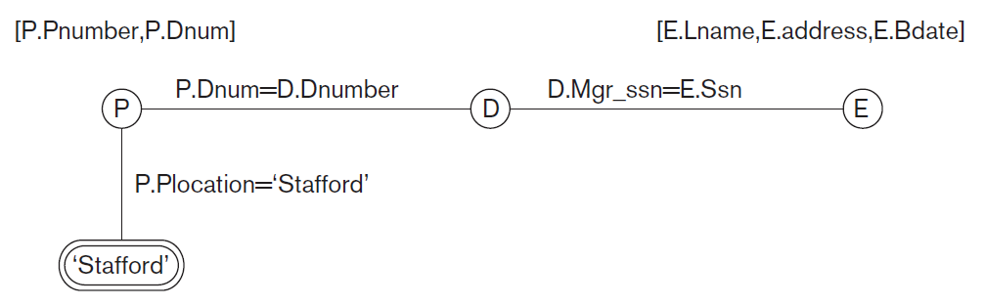
selection and join conditions are represented by graph edges (lines that connect nodes)
attributes to be retrieved from each relation are displayed in square brackets above each relation

Slide 116
Transforming Universal and Existential Quantifiers
(∀x) (P(x)) ≡ NOT (∃x) (NOT (P(x)))
(∃x) (P(x)) ≡ NOT (∀x) (NOT (P(x)))
(∀x) (P(x) AND Q(x)) ≡ NOT (∃x) (NOT (P(x)) OR NOT (Q(x)))
(∀x) (P(x) OR Q(x)) ≡ NOT (∃x) (NOT (P(x)) AND NOT (Q(x)))
(∃x) (P(x)) OR Q(x)) ≡ NOT (∀x) (NOT (P(x)) AND NOT (Q(x)))
(∃x) (P(x) AND Q(x)) ≡ NOT (∀x) (NOT (P(x)) OR NOT (Q(x)))

Slide 117
(∀x)(P(x)) ⇒ (∃x)(P(x))
NOT (∃x)(P(x)) ⇒ NOT (∀x)(P(x))

Slide 118
List the names of employees who work on all the projects controlled by department number 5
{e.Lname, e.Fname | EMPLOYEE(e) AND ((∀x)(NOT(PROJECT(x)) OR NOT (x.Dnum=5) OR ((∃w)(WORKS_ON(w) AND w.Essn=e.Ssn AND x.Pnumber=w.Pno))))}

Slide 119
List the names of employees who have no dependents.
{e.Fname, e.Lname | EMPLOYEE(e) AND (NOT (∃d)(DEPENDENT(d) AND e.Ssn=d.Essn))}
{e.Fname, e.Lname | EMPLOYEE(e) AND ((∀d)(NOT(DEPENDENT(d)) OR NOT(e.Ssn=d.Essn)))}

Slide 120
Safe Expressions
whenever we use universal quantifiers, existential quantifiers, or negation of predicates in a calculus expression, we must make sure that the resulting expression makes sense
a safe expression in relational calculus is one that is guaranteed to yield a finite number of tuples as its result; otherwise, expression is called unsafe.
for example, the expression
{t | NOT (EMPLOYEE(t))}
is unsafe because it yields all tuples in the universe that are not EMPLOYEE tuples, which are infinitely numerous

Slide 121
Domain Relational Calculus

Slide 122
Historically, while SQL was based on tuple relational calculus, was being developed by IBM Research at San Jose, California, another language called QBE (Query-By-Example), which is related to domain calculus, was being developed almost concurrently at IBM T. J. Watson Research Center in Yorktown Heights, New York
formal specification of domain calculus was proposed after the development of the QBE language and system

Slide 123
Domain Variables
domain calculus differs from tuple calculus in the type of variables used in formulas:
Rather than having variables range over tuples, the variables range over single values from domains of attributes
to form a relation of degree n for a query result, we must have n of these domain variables - one for each attribute
expression of the domain calculus is of the form
{x₁, x₂, ..., x_{n} | COND(x₁, x₂, ..., x_{n}, x_{n+1}, x_{n+2}, ...)}

Slide 124
expression of the domain calculus is of the form
{x₁, x₂, ..., x_{n} | COND(x₁, x₂, ..., x_{n}, x_{n+1}, x_{n+2}, ...)}
where x₁, x₂, ..., x_{n}, x_{n+1}, x_{n+2}, ... are domain variables that range over domains (of attributes), and COND is a condition or formula or well-formed formula of the domain relational calculus

Slide 125
a formula is made up of atoms can be one of the following:
atom of the form R(x₁, x₂, … , x_{j}), where R is the name of a relation of degree j and each x_{i}, 1 ≤ i ≤ j, is a domain variable; atom states that a list of values of <x₁, x2, … , x_{j}> must be a tuple in relation whose name is R, where x_{i} is value of the i ^{th} attribute value of tuple to make domain calculus expression more concise, we can drop commas in list of variables:
{x₁, x₂, … , x_{n} | R(x₁ x₂ x₃...) AND ...}
instead of:
{x₁, x₂, … , x_{n} | R(x₁, x₂, x₃...) AND ...}

Slide 126
atom of the form x_{i} op x_{j}, where op is one of the comparison operators in the set {=, <, ≤, >, ≥, ≠}, and x_{i} and x_{j} are domain variables
atom of the form x_{i} op c or c op x_{j}, where op is one of the comparison operators in the set {=, <, ≤, >, ≥, ≠}, x_{i} and x_{j} are domain variables, and c is a constant value

Slide 127
as in tuple calculus, atoms evaluate to either TRUE or FALSE for a specific set of values, called the truth values of the atoms
in similar way to tuple relational calculus, formulas are made up of atoms, variables, and quantifiers, so we will not repeat specifications for formulas
will use lowercase letters l, m, n, … , x, y, z for domain variables

Slide 128
List the birth date and address of the employee whose name is ‘John B. Smith’.
{u, v | (∃q) (∃r) (∃s) (∃t) (∃w) (∃x) (∃y) (∃z) (EMPLOYEE(qrstuvwxyz) AND q=‘John’ AND r=‘B’ AND s=‘Smith’)}
need ten variables for EMPLOYEE relation, one to range over each of domains of attributes of EMPLOYEE in order
of the ten variables q, r, s, … , z, only u and v are free, because they appear to the left of the bar and hence should not be bound to a quantifier

Slide 129
alternative shorthand notation, used in QBE, for writing this query is to assign the constants ‘John’, ‘B’, and ‘Smith’ directly
{u, v | EMPLOYEE(‘John’, ‘B’, ‘Smith’, t, u, v, w, x, y, z)}

Slide 130
Retrieve the name and address of all employees who work for the ‘Research’ department.
{q, s, v | (∃z) (∃l) (∃m) (EMPLOYEE(qrstuvwxyz) AND DEPARTMENT(lmno) AND l=‘Research’ AND m=z)}

Slide 131
QBE language was based on the domain relational calculus, although this was realized later, after the domain calculus was formalized
QBE was one of the first graphical query languages with minimum syntax developed for database systems
is available as an IBM commercial product as part of the Query Management Facility (QMF) interface option to DB2
ideas used in QBE have been applied in several other commercial products

Slide 132
any safe expression in tuple or domain relational calculus can be expressed in the basic relational algebra

